Slide 1

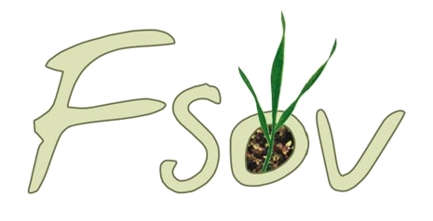





Exploration of calibration strategies for the integration of a new winter wheat cultivar in the STICS crop model
Meije Gawinowski^{1,2}, Maël Aubry³, Samuel Buis⁴, Cécile Garcia², Jean-Charles Deswarte², Marie-Odile Bancal¹, Marie Launay³
¹ Université Paris-Saclay, INRAE, AgroParisTech, UMR ECOSYS, 91120 Palaiseau, France
² Arvalis – Institut du vegetal, Villiers-le-Bâcle, France
³ INRAE, AgroClim, 84914 Avignon, France
⁴ INRAE, UMR 1114 EMMAH, Avignon, France

Slide 2

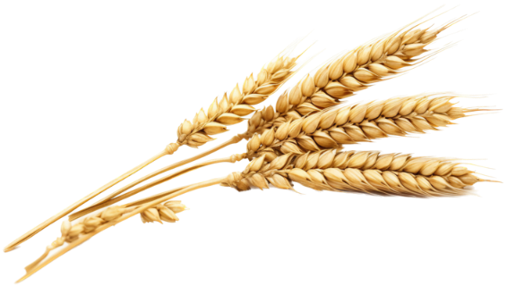
Introduction
Using of crop models
Crop models = process-based model to simulate crop growth, soil water and nitrogen dynamics in response to the environment and agricultural practices
Crop models used for yield prediction, support to crop breeding and assessment of climate change impacts
Major challenge to integrate new cultivars, requiring parameter estimation
The chaos in calibrating crop models (Wallach et al., 2021)
Choices made by the modeler impact calibration outputs
  Parameters to include, range of variation
  Target variables
  Choice of algorithm and loss function
  Sequential vs all-together protocol
  Choice of calibration vs evaluation datasets
AgMIP (Agricultural Model Intercomparison Project) initiative with a calibration exercise
Intercomparison for phenology calibration in Wallach et al. (2023)
New sequential protocol for global calibration proposed and tested on synthetic data in Wallach et al. (2024) with ongoing AgMIP intercomparison
Applying the protocol of Wallach et al. (2024) to estimate a new winter wheat cultivar in the STICS crop model

Slide 3
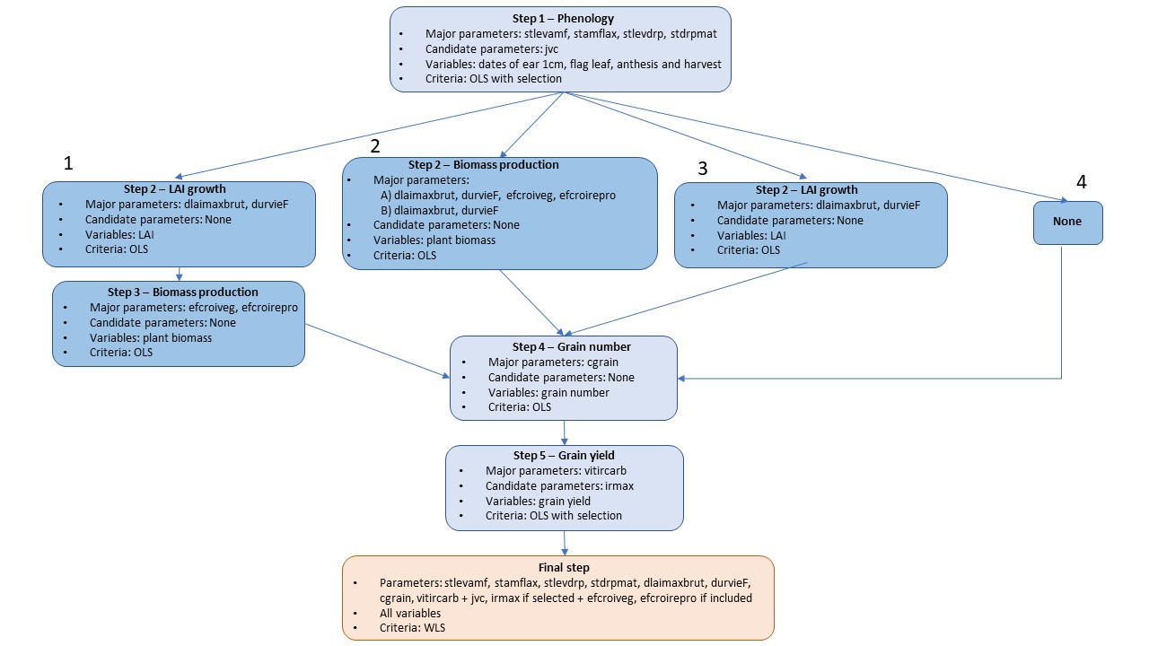
Materials and Methods
Multi-trial French dataset for winter wheat (Arvalis)
Cultivar Rubisko, 82 environments
Cultural practices
Soil characteristics, weather data
Observed target variables
  Phenology
  LAI
  Plant biomass
  Grain number and yield
Calibration methodology
Nelder-Mead simplex algorithm implemented in croptimizR
Calibration (67 environments) and validation (15)
Loss function
  OLS for preliminary steps (blue) with parameter selection (AICc)
  WLS for final step
What is the impact of LAI and plant biomass steps ?

Slide 4
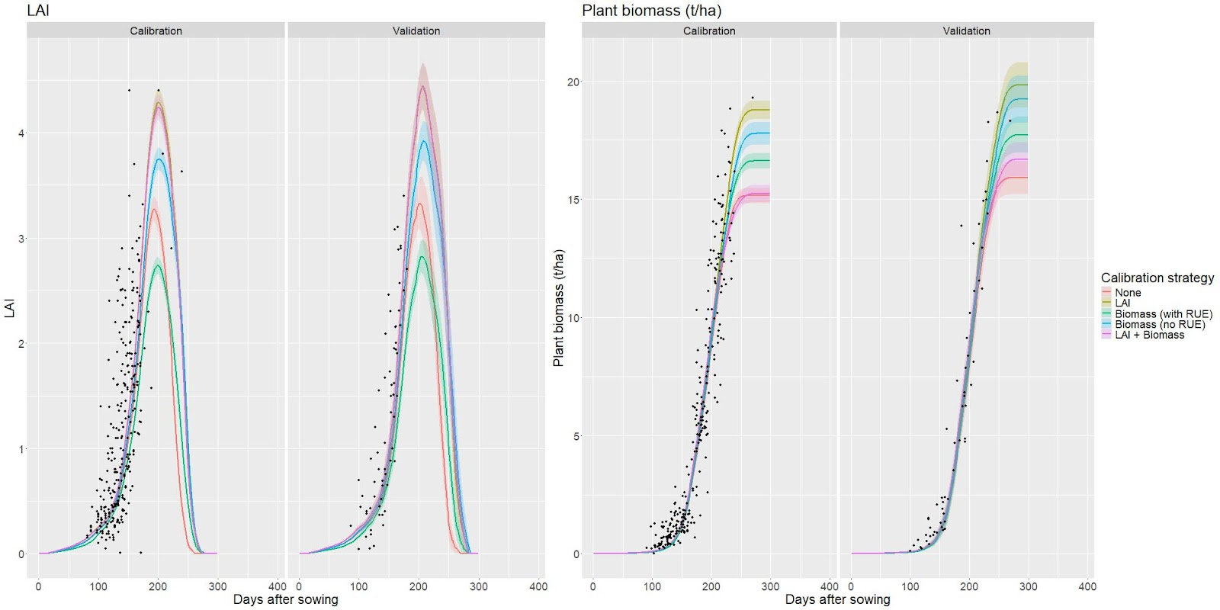
Impact of LAI and biomass in the calibration process

Slide 5
Impact of LAI and biomass in the calibration process
Important differences between strategies

Slide 6
Impact of LAI and biomass in the calibration process
Important differences between strategies
Few observed data at critical periods

Slide 7
Impact of LAI and biomass in the calibration process
Important differences between strategies
Few observed data at critical periods
Best calibration with « LAI » and « Biomass (no RUE) »

Slide 8
Impact of LAI and biomass in the calibration process
Important differences between strategies
Few observed data at critical periods
Best calibration with « LAI » and « Biomass (no RUE) »
« Biomass (with RUE) » with underestimated LAI but compensation for plant biomass → underestimated LAI parameters and overestimated RUE
Surprinsingly « LAI + Biomass » does not perform better

Slide 9
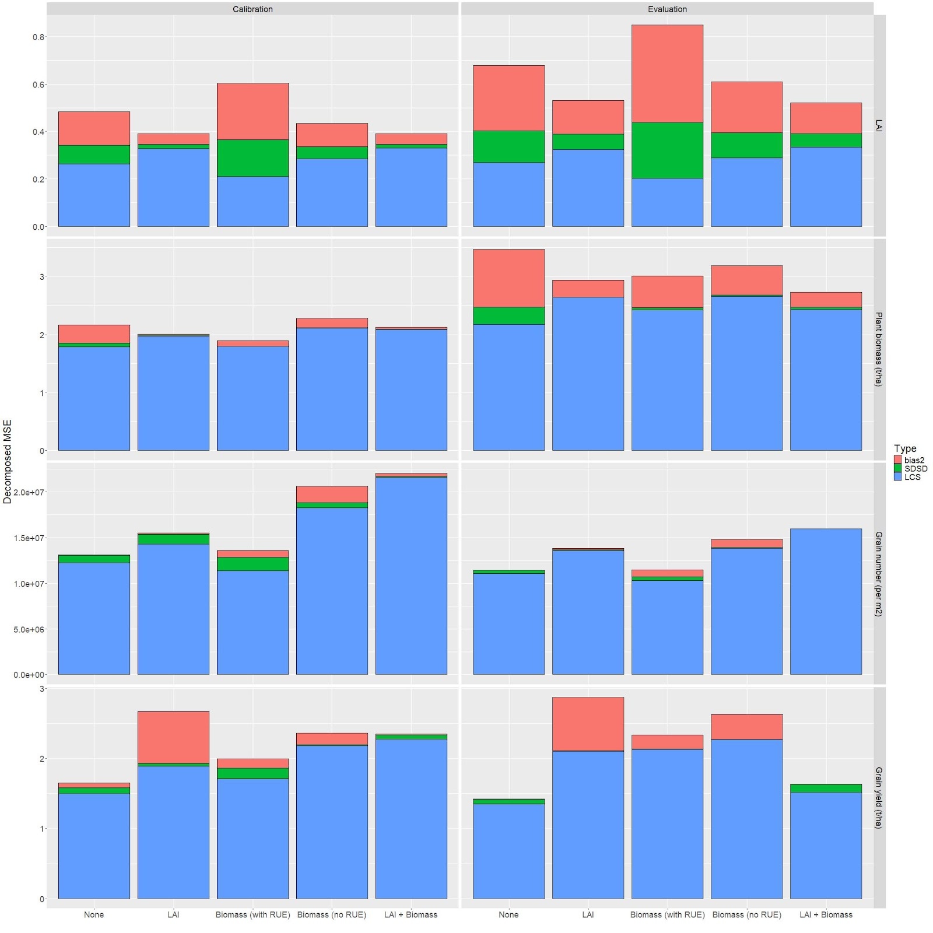

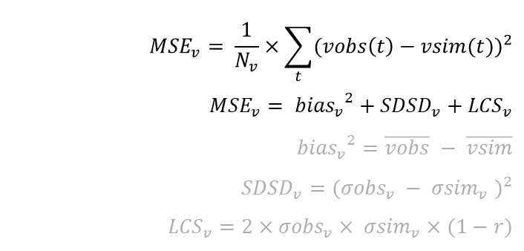
Impact of LAI and biomass on the calibration process
LAI
For each variable $v$ (LAI, plant biomass, grain number, grain weight):
$${MSE}_{v}= \frac{1}{N_{v}}×\sum_{t}{{(vobs\left(t\right)−vsim(t))}^{2}}$$
$${MSE}_{v}= {{bias}_{v}}^{2}+{SDSD}_{v}+{LCS}_{v}$$
$${{bias}_{v}}^{2}=\overline{vobs} − \overline{vsim}$$
$${SDSD}_{v}={({σobs}_{v} − {σsim}_{v} )}^{2}$$
$${LCS}_{v}=2×{σobs}_{v}× {σsim}_{v}×(1−r)$$
Biomass
Grain number
Grain weight

Slide 10
Impact of LAI and biomass on the calibration process
LAI
For each variable $v$ (LAI, plant biomass, grain number, grain weight):
$${MSE}_{v}= \frac{1}{N_{v}}×\sum_{t}{{(vobs\left(t\right)−vsim(t))}^{2}}$$
$${MSE}_{v}= {{bias}_{v}}^{2}+{SDSD}_{v}+{LCS}_{v}$$
$${{bias}_{v}}^{2}=\overline{vobs} − \overline{vsim}$$
$${SDSD}_{v}={({σobs}_{v} − {σsim}_{v} )}^{2}$$
$${LCS}_{v}=2×{σobs}_{v}× {σsim}_{v}×(1−r)$$
Lower LAI MSE for strategies including LAI data
Biomass
Grain number
Grain weight

Slide 11
Impact of LAI and biomass on the calibration process
LAI
For each variable $v$ (LAI, plant biomass, grain number, grain weight):
$${MSE}_{v}= \frac{1}{N_{v}}×\sum_{t}{{(vobs\left(t\right)−vsim(t))}^{2}}$$
$${MSE}_{v}= {{bias}_{v}}^{2}+{SDSD}_{v}+{LCS}_{v}$$
$${{bias}_{v}}^{2}=\overline{vobs} − \overline{vsim}$$
$${SDSD}_{v}={({σobs}_{v} − {σsim}_{v} )}^{2}$$
$${LCS}_{v}=2×{σobs}_{v}× {σsim}_{v}×(1−r)$$
Lower LAI MSE for strategies including LAI data
High bias when LAI parameters calibrated with RUE on biomass
Biomass
Grain number
Grain weight

Slide 12
Impact of LAI and biomass on the calibration process
LAI
For each variable $v$ (LAI, plant biomass, grain number, grain weight):
$${MSE}_{v}= \frac{1}{N_{v}}×\sum_{t}{{(vobs\left(t\right)−vsim(t))}^{2}}$$
$${MSE}_{v}= {{bias}_{v}}^{2}+{SDSD}_{v}+{LCS}_{v}$$
$${{bias}_{v}}^{2}=\overline{vobs} − \overline{vsim}$$
$${SDSD}_{v}={({σobs}_{v} − {σsim}_{v} )}^{2}$$
$${LCS}_{v}=2×{σobs}_{v}× {σsim}_{v}×(1−r)$$
Lower LAI MSE for strategies including LAI data
High bias when LAI parameters calibrated with RUE on biomass
Biomass
Similar biomass MSEs between strategies
Contradiction with visual analysis → to few points near maturity
Grain number
Grain weight

Slide 13
Impact of LAI and biomass on the calibration process
LAI
For each variable $v$ (LAI, plant biomass, grain number, grain weight):
$${MSE}_{v}= \frac{1}{N_{v}}×\sum_{t}{{(vobs\left(t\right)−vsim(t))}^{2}}$$
$${MSE}_{v}= {{bias}_{v}}^{2}+{SDSD}_{v}+{LCS}_{v}$$
$${{bias}_{v}}^{2}=\overline{vobs} − \overline{vsim}$$
$${SDSD}_{v}={({σobs}_{v} − {σsim}_{v} )}^{2}$$
$${LCS}_{v}=2×{σobs}_{v}× {σsim}_{v}×(1−r)$$
Lower LAI MSE for strategies including LAI data
High bias when LAI parameters calibrated with RUE on biomass
Biomass
Similar biomass MSEs between strategies
Contradiction with visual analysis → to few points near maturity
Grain number
Lower grain number/weight MSEs without LAI and biomass data
Grain weight

Slide 14
Impact of LAI and biomass on the calibration process
LAI
For each variable $v$ (LAI, plant biomass, grain number, grain weight):
$${MSE}_{v}= \frac{1}{N_{v}}×\sum_{t}{{(vobs\left(t\right)−vsim(t))}^{2}}$$
$${MSE}_{v}= {{bias}_{v}}^{2}+{SDSD}_{v}+{LCS}_{v}$$
$${{bias}_{v}}^{2}=\overline{vobs} − \overline{vsim}$$
$${SDSD}_{v}={({σobs}_{v} − {σsim}_{v} )}^{2}$$
$${LCS}_{v}=2×{σobs}_{v}× {σsim}_{v}×(1−r)$$
Lower LAI MSE for strategies including LAI data
High bias when LAI parameters calibrated with RUE on biomass
Biomass
Similar biomass MSEs between strategies
Contradiction with visual analysis → to few points near maturity
Grain number
Lower grain number/weight MSEs without LAI and biomass data
High grain number MSE for « Biomass (no RUE) »
Grain weight

Slide 15
Impact of LAI and biomass on the calibration process
LAI
For each variable $v$ (LAI, plant biomass, grain number, grain weight):
$${MSE}_{v}= \frac{1}{N_{v}}×\sum_{t}{{(vobs\left(t\right)−vsim(t))}^{2}}$$
$${MSE}_{v}= {{bias}_{v}}^{2}+{SDSD}_{v}+{LCS}_{v}$$
$${{bias}_{v}}^{2}=\overline{vobs} − \overline{vsim}$$
$${SDSD}_{v}={({σobs}_{v} − {σsim}_{v} )}^{2}$$
$${LCS}_{v}=2×{σobs}_{v}× {σsim}_{v}×(1−r)$$
Lower LAI MSE for strategies including LAI data
High bias when LAI parameters calibrated with RUE on biomass
Biomass
Similar biomass MSEs between strategies
Contradiction with visual analysis → to few points near maturity
Grain number
Lower grain number/weight MSEs without LAI and biomass data
High grain number MSE for « Biomass (no RUE) »
Highest grain weight MSE for « LAI »
Grain weight

Slide 16
Impact of LAI and biomass on the calibration process
LAI
For each variable $v$ (LAI, plant biomass, grain number, grain weight):
$${MSE}_{v}= \frac{1}{N_{v}}×\sum_{t}{{(vobs\left(t\right)−vsim(t))}^{2}}$$
$${MSE}_{v}= {{bias}_{v}}^{2}+{SDSD}_{v}+{LCS}_{v}$$
$${{bias}_{v}}^{2}=\overline{vobs} − \overline{vsim}$$
$${SDSD}_{v}={({σobs}_{v} − {σsim}_{v} )}^{2}$$
$${LCS}_{v}=2×{σobs}_{v}× {σsim}_{v}×(1−r)$$
Lower LAI MSE for strategies including LAI data
High bias when LAI parameters calibrated with RUE on biomass
Biomass
Similar biomass MSEs between strategies
Contradiction with visual analysis → to few points near maturity
Grain number
Lower grain number/weight MSEs without LAI and biomass data
High grain number MSE for « Biomass (no RUE) »
Highest grain weight MSE for « LAI »
Grain weight
« Biomass (no RUE) » strategy is the best one with satisfying LAI and biomass error, good visual fit and limited bias on yield (but bias on grain number)

Slide 17
Impact of temporal acquisition on the calibration process
Important lack of observed data during maximum LAI and senescence for LAI and near maturity for plant biomass

Slide 18
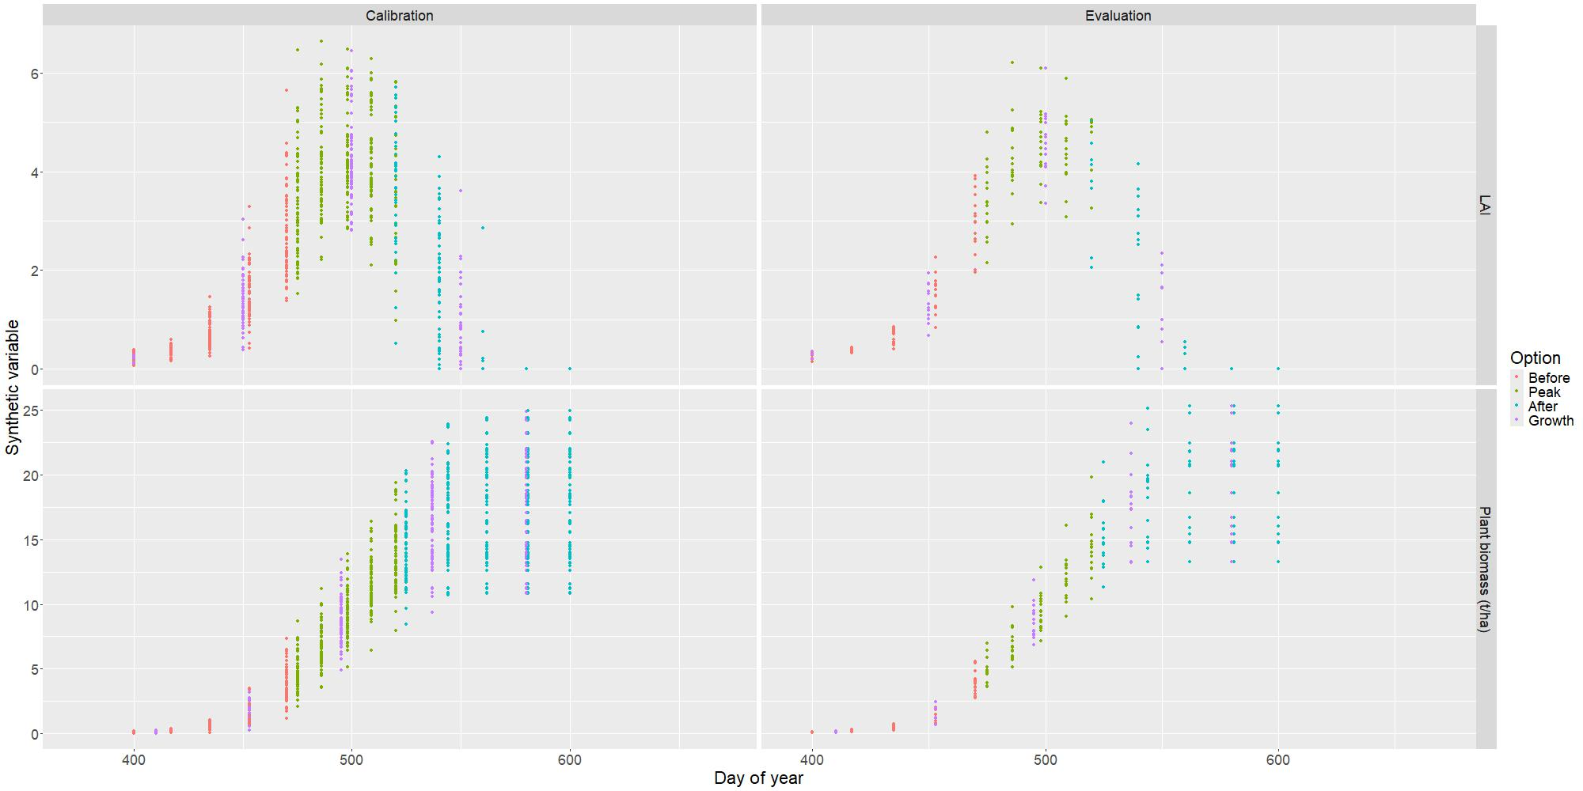
Impact of temporal acquisition on the calibration process
Important lack of observed data during maximum LAI and senescence for LAI and near maturity for plant biomass
Exploration on synthetic data
  For LAI and plant biomass separately
  Simulations with « LAI » and « Biomass (no RUE) »
  5 samples for each environment
  Sampling at regular time intervals
  Addition of Gaussian noise
  Observed data for other variables
  4 temporal options around LAI pic
    Before
    Peak
    After
    Growth

Slide 19
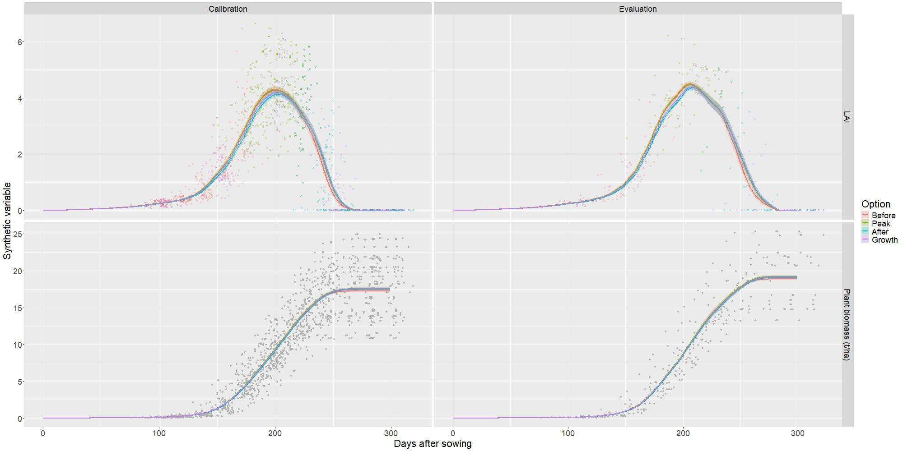
Impact of temporal acquisition on the calibration process
Calibration on observed phenology, grain number and yield + synthetic LAI

Slide 20
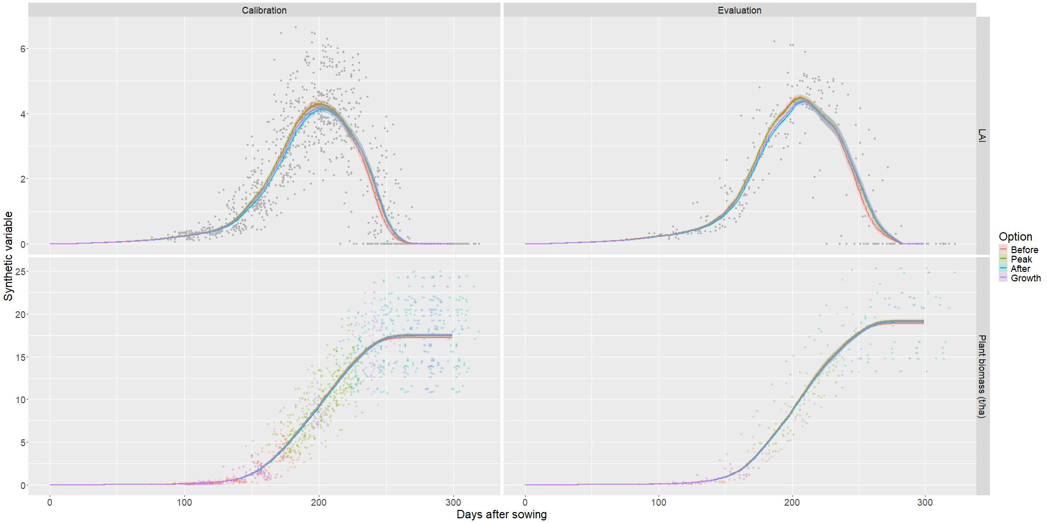
Impact of temporal acquisition on the calibration process
Calibration on observed phenology, grain number and yield + synthetic plant biomass

Slide 21
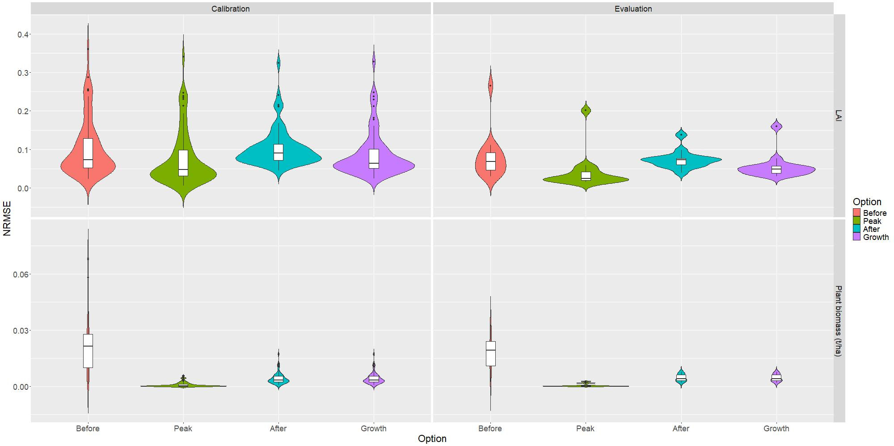
Impact of temporal acquisition on the calibration process
NRMSE distribution of calibrated synthetic variables
Low magnitude of errors
« Before » strategy is the worst option
« Peak » strategy with lowest mean NRMSE on LAI and plant biomass
With a synthetic homogeneous dataset, there are few differences between temporal options but sampling around maximum LAI is the best option.

Slide 22
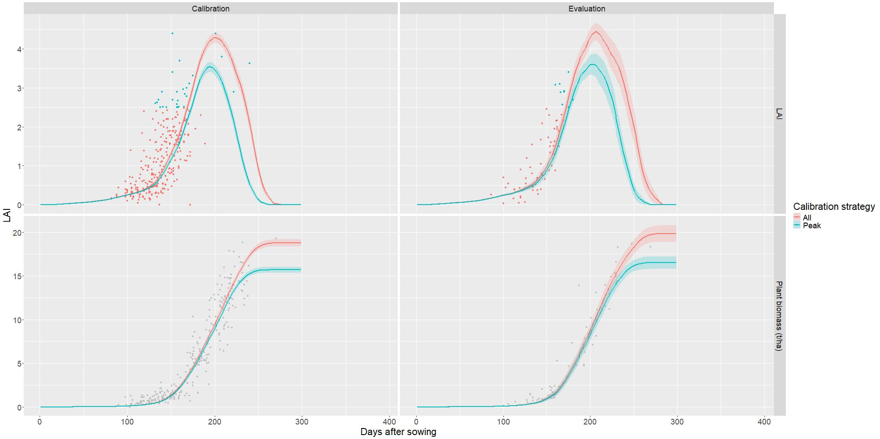
Calibrating on observed data around maximum LAI
For our specific dataset, is it better to only take data around maximum LAI to calibrate LAI or plant biomass?
Calibration on observed phenology, grain number and yield + synthetic LAI → comparison between all observations (red) and peak ones (blue)
Visual underestimation of LAI peak and plant biomass at maturity
Higher NRMSE values
Too few data around maximum LAI for a performant calibration

Slide 23
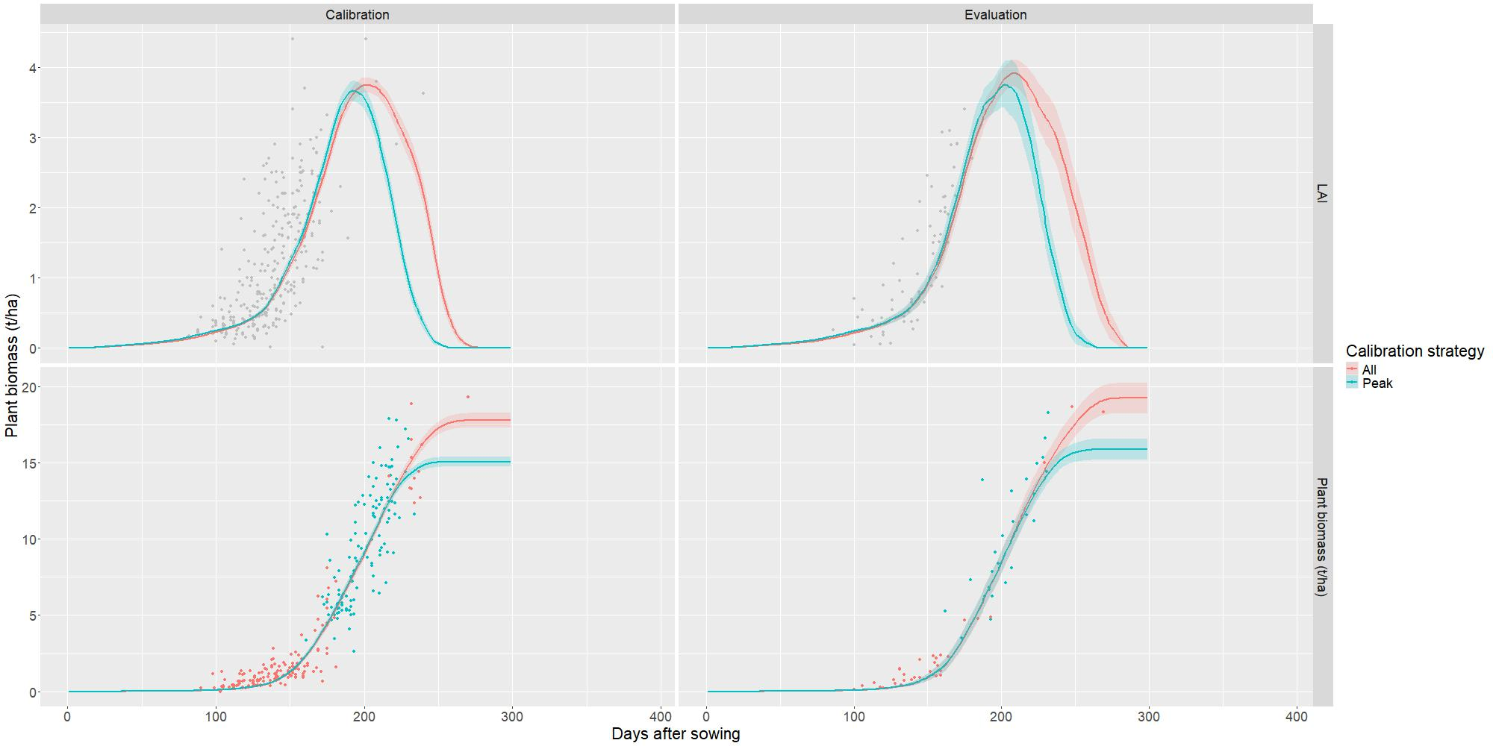
Calibrating on observed data around maximum LAI
For our specific dataset, is it better to only take data around maximum LAI to calibrate LAI or plant biomass?
Calibration on observed phenology, grain number and yield + synthetic biomass → comparison between all observations (red) and peak ones (blue)
Visual underestimation of LAI peak and plant biomass at maturity
Higher NRMSE values
No biomass data at maturity
Synthetic results not transferrable to observed data due to the difference in data structure.

Slide 24
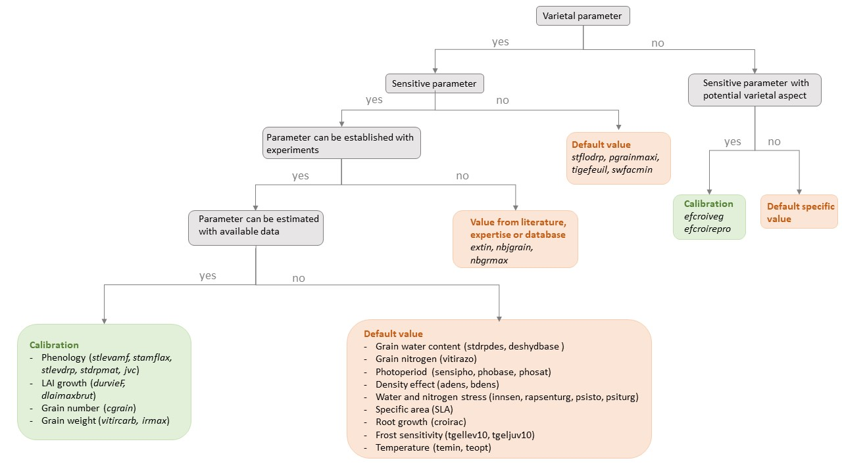
Conclusions, recommendations and perspectives
Guidelines for calibrating a new cultivar
Decision tree for selection of parameters to calibrate
Calibration strategy depends on data structure
Strategy « Biomass (no RUE) » recommended, exclusion of RUE parameters
Efforts for more homogeneous data acquisition throughout growth with a focus on biomass at maturity
Perspectives
Replace LAI by fAPAR
Improve calibration performance with
  Weighted RMSEs
  Combination with machine learning approaches?

Slide 25
Merci pour votre attention !

